Slide 1

LSTM Text Generation and Classification
DSC 680 Applied Data Science
February 27, 2021
Kyle Morris
Notes:
Good evening! My name is Kyle Morris and welcome to the third and final project of my DSC 680 Applied Data Science Capstone Presentation.
Video game development costs have skyrocketed over the last few decades. In an attempt to control costs, developers are turning to procedureally generated content in order to fill in their game worlds. We were interested in a subset of that specifically involving text. We will be training our text model based on a specific text, then generated new text based on our model. Then, we will pit a classification model against our generated text to see if we can generate text that fools the classification model. Let’s see how it turned out!

Slide 2

Agenda
Business Uses
Our Data
Methodology
Results
Closing
Q&A
Notes:
Here is what we are going to cover in our presentation today. We’re going to talk about some of the business uses of our text generation and how it can be useful. We’re going to talk a little bit about the data we used, and then we’re going to talk about the methodology we used to compile our results.
Then we’re going to look at said results, and see what kind of conclusions we can come to regarding the text we generated and how well it performed against our classification model. Finally we’re going to wrap things up, and there will be a brief Q&A session. Without any further ado, let’s begin.

Slide 3

Business Uses
Procedural Text Generation
Predictive Text
Procedural Game Design
Notes:
As I mentioned in my introduction, video game development costs have skyrocketed, while expectations of gamers have continued to skyrocket right along with them. Many Open World narratives released today immerse you in the fictional realm that they are set in, with their own histories and legends. If a team were to truly take the time to flesh out everything, it would take hundreds and thousands of man-hours. Is there a way that we could procedurally generate some of this content, thereby freeing up developers to work on other aspects of development?
This was the question that set us down the rabbit hole. Could we spend time creating a base corpus, that sets the outline of our fantasy world and the writing that is found within it and then, using that to train our model, flesh out the rest of the text in our game?
Another use of predictive text can be found when you’re writing emails. Many email clients these days suggest sentence endings. Imagine being a technician, out on a job site, trying to fill in the notes for services performed. Often times, you’re going to be reporting similar outcomes and typing on a smartphone isn’t the quickest input method. Text generation could speed things up immensely.

Slide 4
Our Data
Source Corpus
Generated Text
Classification
Sir Arthur Conan Doyle’s “The Hound of the Baskervilles”
59,400 words.
6,105 Unique Words
15 datasets created
Each dataset:
~1,000 rows of actual text.
~1,000 rows of generated text.
Temperatures range from .1 to 1.25.
60 epochs used to train the model.
Utilizes logistic regression to classify.
Notes:
In order to train our model, we needed a corpus, or collection of written words. We went to the public domain for this one and chose “The Hound of the Baskervilles”, the classic Sherlock Holmes tale. The text consisted of 59,400 word of which 6,105 were unique.
From this text, we trained our model to predict the probabilities for each character and chose the most likely one. This training went on for 60 epochs and then our samples were generated. We pulled 1000 rows of actual text and generated 1000 or so rows at each temperature value from .1 to 1.25, giving us a final database of nearly 16,000 rows.

Slide 5
Our Data
2 Columns
Important Columns
Since the “temperature” column was a range, we needed to eventually convert this to a Boolean that was 0 for real text and 1 for generated text, but in order to split our data up we needed the temperature logged.
The text had a lot of symbols and extraneous text. We needed to do something about that as well.
Temperature column represented the temperature used to generate the text, or -1 to indicate original text.
“text” was the second column and consisted of the text of the message.
Notes:
Our data had two columns. The first was the temperature column, which is the parameter which we could vary for the generation of text. Depending on what level the temperature was set to, the output of the generator varied greatly. We stepped between .1 and 1.25 with a step of .1, adding .25, .75, and 1.25 to the mix as well.
The other column was the actual text, either generated or from the original sample. This text in the original form includes punctuation and stopwords. We will need to clean that up in the actual data prep portion of our project.

Slide 6

Methodology
Data Preparation
Visualizations
Import Corpus
Train Text Generation Model
Complete Dataset
Split Datasets
Train each model
Test each model
Confusion Matrix created for each model.
Temperature versus F-Score to view results.
Models
LSTM Text Generation
Logistic Regression
Notes:
We imported our corpus, the text of the Hound of the Baskervilles, and vectorized it. Then, for 60 epochs, we trained our model based on the original text. Once that had completed, we needed to create our training and test datasets.
To do this, we varied the “temperature” parameter. For each pass, we sampled a random section of the text approximately 400 characters long, then used the first 60 characters to generate each line at each temperature.
This gave us a dataset consisting of about 16,000 rows. We then created 15 different datasets, consisting of the sample data and the 1000 rows generated at each temperature. Thus, we could train each model given a sample from the novel and a specific temperature instead of intermixing. Once each dataset was created, we then created a separate logistic regression classification model for each and recorded the F-Score of the output. A confusion matrix was created for each trial to show how accurate that model was at identifying generated text, and the F-Score was recorded along with the temperature used to create the later visualizations.

Slide 7
Epoch 1 Versus 60
.
“that is in answer to mine of this morning. he is the staft upon
a private find into the stapletons.”
“it is a long who some assustions of the case to i seems that the
experience of stand poor from a stapleton was contain to me
could not go him and he is baged the man like a good before the
throat?”
“yes.”
“i have not a must be find here. i must remoder to the way of the
on the moor. he proved to be a blackguard and deserted the
been liventer had not a meing he up the mass of a rear it which
expace complece to the was his the care his the mare the came
that it for a leans for the gooo” he in the complicale of the
of the race heard it a cloom had here by the dary the case of the
this my that the moor. by a read and he the was a been you have
it was you say peen be a course in my pap
Notes:
Here is an example of how the model was refined over time. The first one is taken from the very first training pass, and the second is from the last training pass. As you can see, less typos and our model got much more creative with line breaks over time. Both of these paragraphs were generated with the same temperature, 0.5. Let’s see how the same source line looks at different temperatures on the next slide.

Slide 8
Varying Temperatures
Temperature | Text
Initial Seed | “what do you say, watson?”
.2 | i shrugged my shoulder was all way the stapleton was position of the hound was a clear with the crosical was a contrive which
.7 | i shrugged my shoulder that watson all, gentiver two of inteersted. that she was guetopence, and all resided. all was man himself be
1.1 | i shrugged my shoulder. there was my which became by arm. barrymore ship?”
1.25 | i shrugged my shoulder anmesorg enough after the never death of risen.”
Notes:
Here’s a good example of the same initial seed “what do you say, Watson?” has a very similar beginning response regardless of the temperature. Apparently, Watson likes to shrug his shoulders a lot. But after that we begin seeing a lot more variation. Since we’re predicting the next character, not the next word, we do see some creative words especially in the .2 temperature and the 1.25 temperature. But the 1.1 was mostly normal. Will that be enough to fool our classification algorithm?

Slide 9
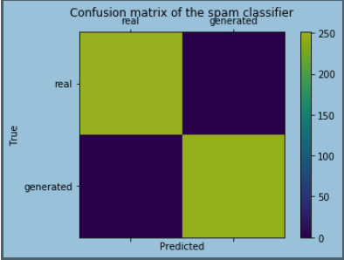
Confusion Matrix Temperature – 0.1
251 | 0
0 | 249
Notes:
Here’s the results of the first classification model with temperature equal to 0.1. The confusion matrix is a way of showing the performance of a model. Essentially, instead of just spitting out a value for accuracy, which we have, the confusion matrix lets us see how the guesses were wrong. Wow, we couldn’t get a thing past our classifier for the first model where our temperature was 0.1. The model identified every single real text as real and every single generated text as generated. Hopefully we’ll be able to start fooling them.

Slide 10
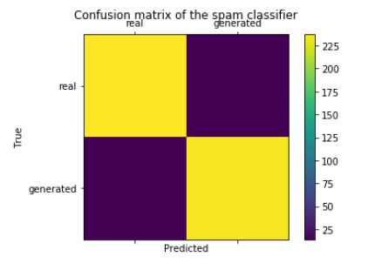
Confusion Matrix Temperature = 1.25
237 | 14
15 | 234
Notes:
Wow! Paydirt! At the highest temperature level, 1.25, we were actually only about 94% accurate. Our model misidentified 15 generated rows as real, and 14 real rows as generated. This is what we were hoping to see. But as we showed earlier, as we reached the higher temperature levels we found that the generated text was easier to identify to a human observer. Is there a good trade off between “fools a machine” and “fools a human”? Let’s take a look at a chart we put together graphing the temperature versus F-Score for every data set.

Slide 11
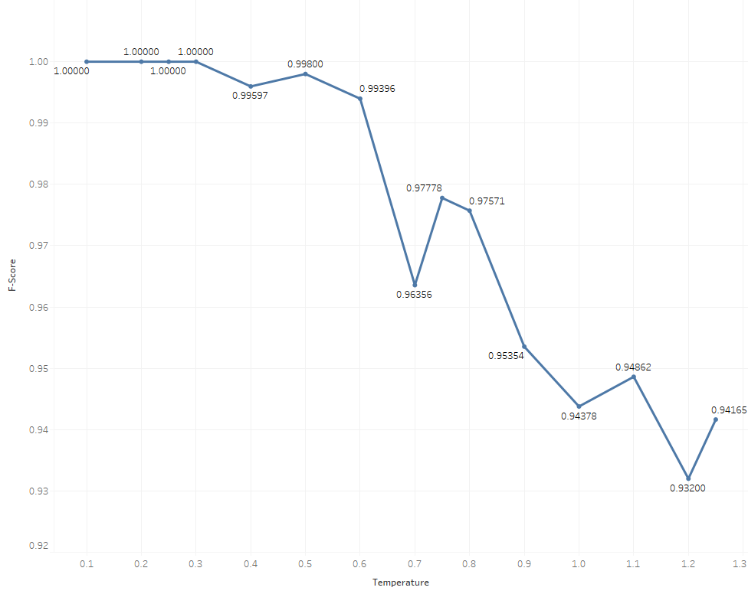
Final Results F-Score Versus Temperature
Notes:
We actually ended up having a pretty decent drop off in accurarcy. Granted, our lowest was around 94% but as you can see we had a couple of peaks and valleys. We got a really good performance number out of temperature = 0.7, which based on this graph is going to be my recommended temperature. Given refinements to the original text model, I think we can get this accuracy even lower but it was nice to see that varying the temperature had such a dramatic effect on the model’s accuracy. After the first few 100% results, we were worried it was going to be too easy to pick out the generated text but this wasn’t the case. I’d call that mission success.

Slide 12

Conclusion
Proof of concept
Accurate Classification
Further Uses
Adaptability
Kyle
kymorris@my365.Bellevue.edu
Notes:
Overall, I’m happy with how things turned out! With a few of the early temperatures, we had 100% accuracy which wasn’t ideal for our purposes but we did eventually get to the point where we were beginning to fool our model. Based on our results, I would suggest somewhere in the .7 to .8 range for temperature to have a better shot at fooling both machine and humans.
The technology isn’t perfect but it is a start. I wouldn’t be surprised to find out this concept is expanded and utilized in actual development within a few years. The results were surprisingly positive.
We used Sherlock Holmes, but any corpus can be used. We would recommend one with a good variety of words – you just are not going to get great results with a thousand word corpus.
This project turned out just as interesting as I imagined. I hope you enjoyed learning about this particular technique.

Slide 13
Q&A
Questions
What made you decide on text generation?
Why Sherlock Holmes?
What was the reasoning behind the different temperatures you used?
Are there any examples of games that actually use similar technology?
What was the most surprising thing you discovered?
What refinements to the process do you see being the next steps?
What causes the random nonwords in the generated text?
You mentioned generating characters instead of words. Would generating text result in better generated text?
Why did you choose logistic regression for the classification algorithm?
Isn’t the F-Score the same as the accuracy? Why were both reported?

